Slide 1
Recitation 7

Slide 2
Info
Jon Rutkauskas
Recitation: Tue 12-12:50
Office Hours: Tue 11-11:50 Thur 11-12:50 SENSQ 5806 (additional hours by appointment if needed)
On discord: @jrutkauskas
By email: jsr68@pitt.edu
Github: https://github.com/jrutkauskas/spring2019-449-rec
Ask me any questions you have!!!

Slide 3
Exam 1
So, most of you have taken it. Officially, this section has, but if anyone is in the Tu/Th section, you have your exam today… and soon. So, technically we can’t talk about the test.
But how was it? How did it go? 👍/👎?
I can answer some review questions, though.

Slide 4
Warmup Polls

Slide 5
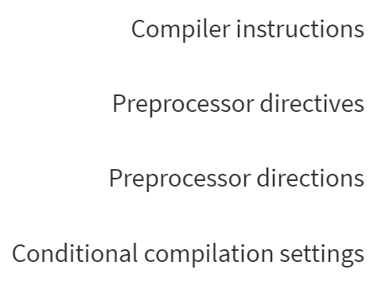
What are #define, #include, #ifndef, #if, etc. called?

Slide 6
What are #define, #include, #ifndef, #if, etc. called?
These lines starting with # are called preprocessor directives
They ‘direct’ the preprocessor to do something to your code

Slide 7
To Begin
Are there any questions on anything in 449?

Slide 8
To Begin
There are no projects out yet.
No labs either… (but one is coming soon)
You haven’t learned anything new in class since last week
So………………………………………………………………………………………………………………………………………………………………………………………………………………………………………………………………

Slide 9
So, what all do you want to cover today?
Optional – We can learn how to use Git and Github, which are good skills to have. Totally not needed for class, but still can be nice.
https://github.com/laboon/friendly_introduction_git
Optional Activity – Implement a Queue in C. Again, not needed for this class but a good activity to get a bit more practice with some data structures and C.
We can also talk about literally whatever you want.
Y’all have other classes?

